Slide 1



Tracking the evolution of pathogens over time
Site and clock models in phylogenetics
Nicola F. Müller
e-mail: nicola.felix.mueller@gmail.com
twitter: @nicfelm

Slide 2
Tracking the evolution of pathogens over time is all about the tree likelihood
Tree likelihood
Du Plessis et al., 2015, Trends M.

Slide 3
Phylogenetic trees denote the evolutionary relationship between individuals.
Notes:
At the heart of phylogenetics are phylogenetic trees
Phylogenetic trees denote how individuals are related.
These individuals can be viruses, bacteria, humans, entire species, or even languages.
In the example shown here, we consider pathogens in different hosts.
Let’s assume the following: Patient blue gets infected from somewhere and is our patient 0.
Patient blue then infects patient green, who then transmits to patient red.

Slide 4
The spread of pathogens between hosts over time can be described by a phylogenetic tree.
Notes:
Phylogenetic trees are often shown as timed phylogenetic trees, where the timing of a coalescent event or sampling event corresponds to some time in the past.
The way to read them is that this tip and this tip last shared a common ancestor at this time.

Slide 5
When pathogens replicate within infected individuals, random errors occur, some of which will rise to fixation.
Notes:
During replication of pathogens, random errors occur, which may rise to fixation.
Over time, random errors accumulate.

Slide 6
We can access some of this information by sequencing pathogens at the “tips” of phylogenetic trees.
Notes:
If we then go and sequence pathogens isolated from different hosts, the sequence data will look differently depending on how far apart in the transmission history they are
The further apart in the transmission history two isolated are, the more diverged the genetic sequence data will be.
Additional to the genomic sequences, we often know when a sample was isolated from a patient, which gives us some information about how these errors accumulate over time

Slide 7
This results in the data, i.e. a sequence alignment and the information when a sequence was isolated from a patient.
Notes:
The genetic sequence data and sample isolation time constitute the data in our later models and are typically in the form of a multiple sequence alignment with sampling times.

Slide 8
Phylogenetic methods allow us to re-infer the transmission history from genetic sequences
Notes:
We can then use mathematical models to get from a multiple sequence alignment and sampling times to an estimate of these sequences relate over time.
This relation over time is denoted by a timed phylogenetic trees.

Slide 9
Notes:
To get from a multiple sequence alignment to a timed phylogenetic trees, we use evolutionary models that are often split into two parts.
The Site model tells us how we can get from a multiple sequence alignment (without using sampling times) to a divergence tree.
This divergence tree has a branch length genetic distance.
To get from a divergence tree to a tree where the branch lengths and node heights are in actual time, we use clock models.
Clock models are essentially mathematical functions to map genetic distance into time.
The simplest form of these molecular clock models are strict clocks, which essentially assume that evolution happens at the same speed everywhere on the tree.
Also, as a side comment, insertions and deletions are typically ignored in phylogenetic reconstructions.

Slide 10
Site models describe the relative change across nucleotides and positions in the alignment and consist of several parts.
Substitution models describe how fast/slow the change from one to another nucleotide happens compared to others
Gamma rate heterogeneity models describe how fast/slow some sites in an alignment change bases compared to others
Codon positions models allow for some codon positions to evolve faster/slower than others

Slide 11
Substitution models allow to account for differences in nucleotide substitution rates.
Rate Matrix
Base Frequencies
b
A
G
f
π_{A} + π_{C} + π_{G} + π_{T} = 1
d
c
C
T
e
(slide adapted from Sebastian Duchene)
Notes:
Substitution models denote how changes occur between different characters.
Typically, these characters are nucleotides, but they can also be amino acids or some other discrete, or even continuous character.
Geographical location can, for example, also be modelled using the same approach (more about that on Friday)

Slide 12
Substitution models allow to account for differences in nucleotide substitution rates.
Rate Matrix
Base Frequencies
b
A
G
f
π_{A} + π_{C} + π_{G} + π_{T} = 1
d
c
C
T
e
JC
a=b=c=d=e=f
π_{A}=π_{C}=π_{G}=π_{T}
0 free parameters
HKY
a=c=d=f, b=e
π_{A}, π_{C}, π_{G}, π_{T}
4 free parameters
GTR
a, b, c, d, e, f
π_{A}, π_{C}, π_{G}, π_{T}
8 free parameters
(slide from Sebastian Duchene)

Slide 13
Some sites in the alignment might be more flexible and therefore evolve more quickly.
CTAT--GGCACCCAGCCCATGCAT-GGT
CTAA--GGCAACCAGCCCATACAT-GCT
CTATGTGGCAACCAGCCCATGCAT-GCT
ATATGTGGCAGCCAG-----GCATAGGT
ATATGTGGCAGCCAGCCCATGCATAGGT
Medium
Slow
Fast
(slide from Sebastian Duchene)

Slide 14
Proportion of invariable sites account for sites that do not change (e.g., HKY+I).
1
Proportion of sites
1-P_{inv}
P_{inv}
0
Rate
(slide from Sebastian Duchene)

Slide 15
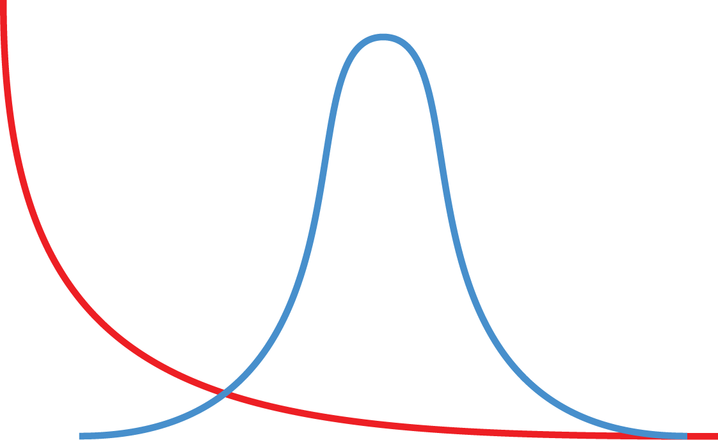
Gamma rate heterogeneity models account for rate differences across sites (e.g. HKY+G₄).
alpha=0.5
alpha=100
Proportion of sites
0
(slide from Sebastian Duchene)

Slide 16
Changes in the third codon position are far more likely to not affect the amino acid
Splitting up the alignment into different codon positions and allow each having its own site model allows accounting for these differences
https://www.genomenon.com/codon-chart/

Slide 17
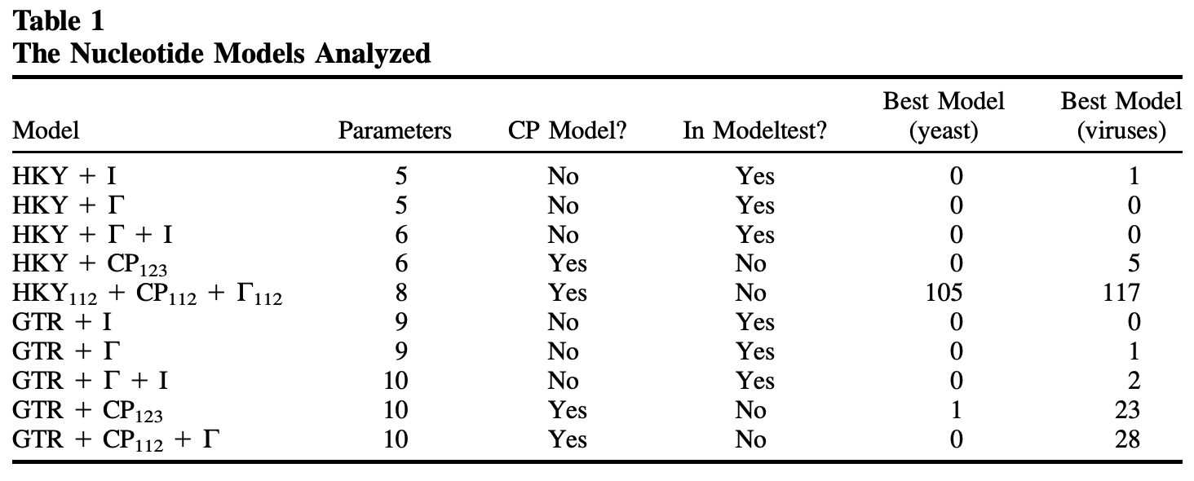
Accounting for rate variation between codon positions is almost always better
Shapiro et al., 2006, MBE

Slide 18
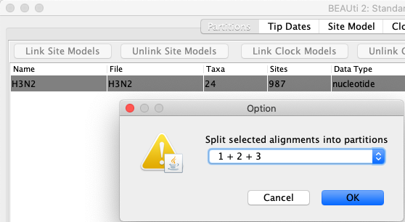
Accounting for different rates across different codon positions in BEAST2 is achievied by splitting an alignment

Slide 19
Practical considerations
Everything affects everything in Bayesian phylogenetics. Wrong evolutionary models lead to wrong trees, which leads to wrong population parameters.
Overparameterization is better than under-parameterization. In doubt, use the more complex site model, such as a GTR+ model (Abadi et al., 2019, Nat. comm.)
Never forget to account for rate heterogeneity (experience). (And, the JC69 model is hardly ever appropriate).

Slide 20
QUESTIONS?

Slide 21
The molecular clock

Slide 22
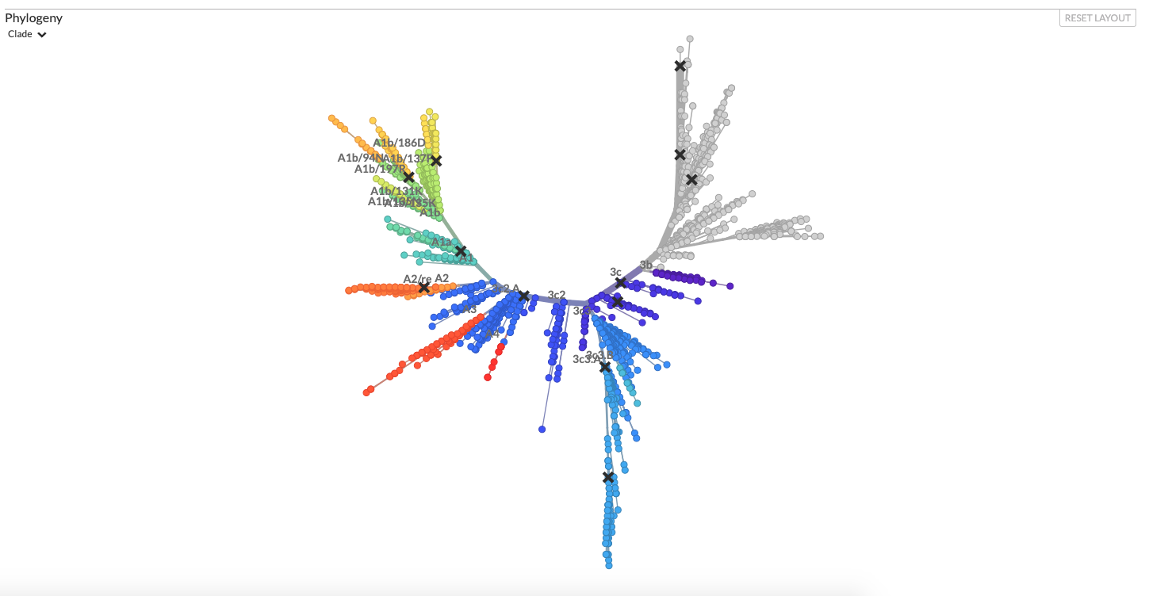
Using site models, we can get from alignments to divergence trees
nextstrain.com

Slide 23
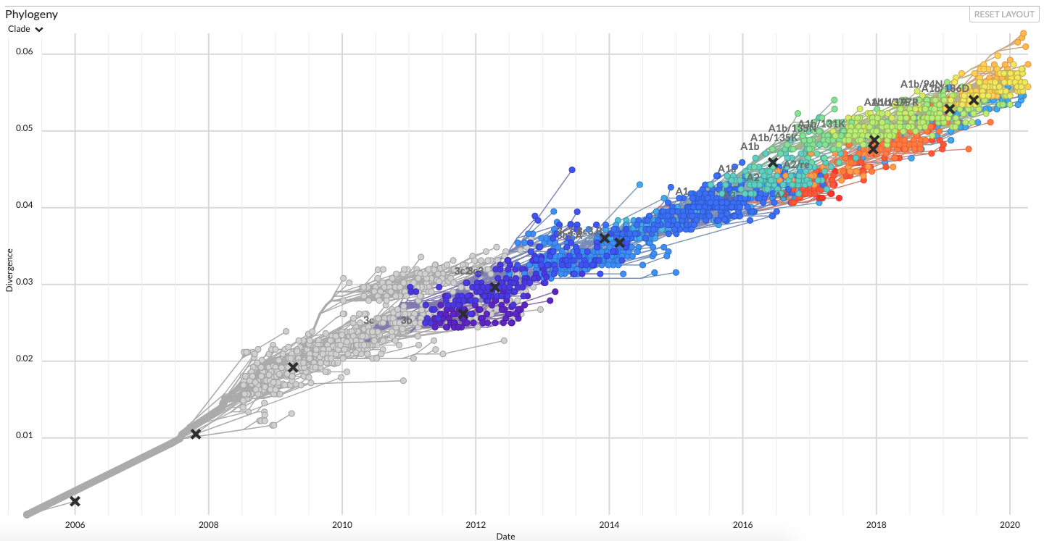
Sequences that are further apart in time are more diverged
nextstrain.com

Slide 24
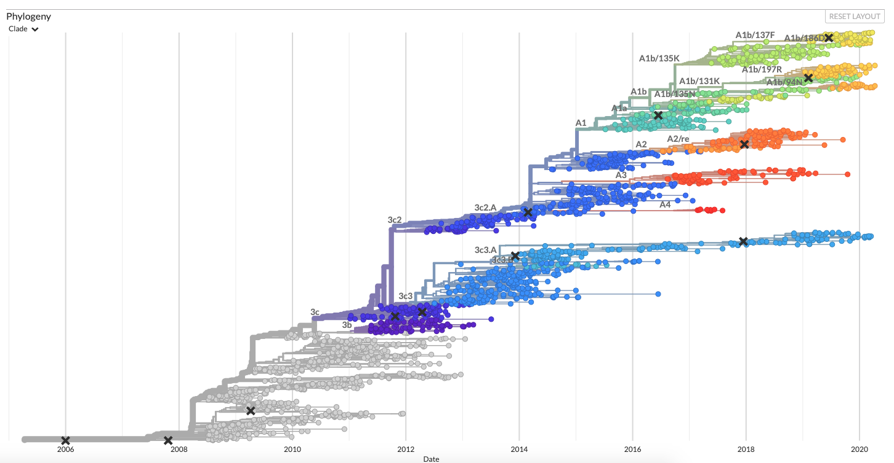
Molecular clocks bring us from divergence trees to time trees
nextstrain.com

Slide 25
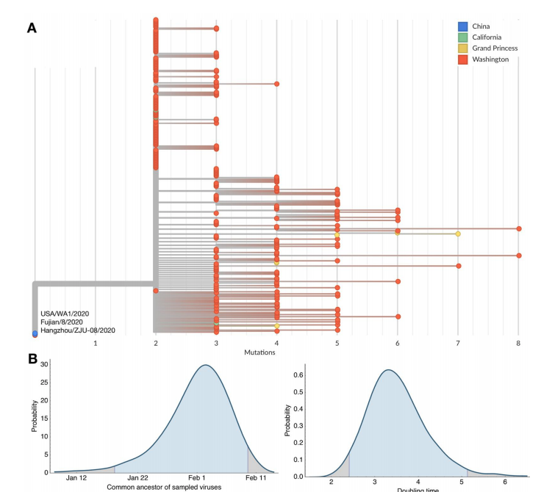
Evolutionary models can be used to estimate common ancestor times
Bedford et al., 2020, Science

Slide 26
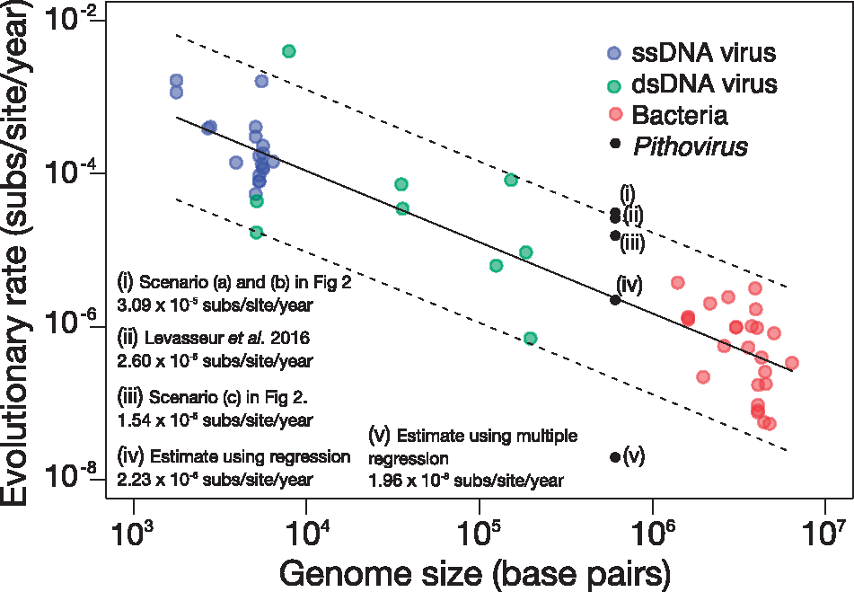
Different organisms have vastly different rates of evolution
Duchene et al., 2018, Vir. Evol.

Slide 27
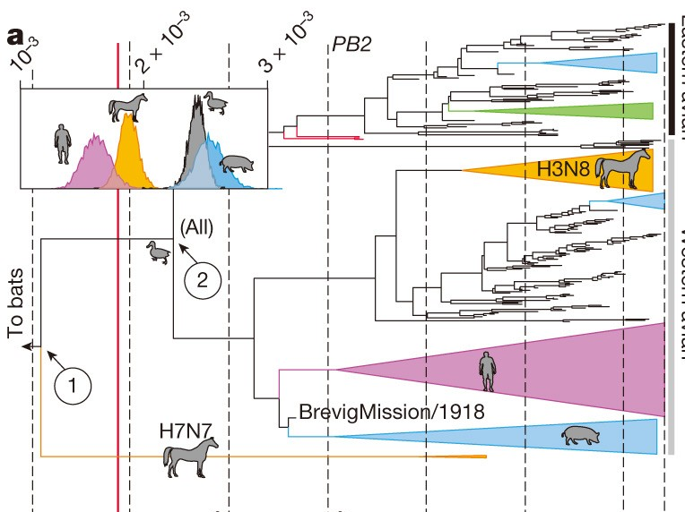
Rates of evolution can vary due to different hosts
Worobey et al. (2014), Nature
Notes:
This strict clock model assumption is, however, often broken.
In this example, by Worobey et. al, they looked at if the rates of evolution varied in influenza for different host species and found that they indeed where higher in pigs and birds, compared to times when humans or horses where the host species.

Slide 28
What is my clock rate? (from Holmes et al. 2016
Mutation rate (short term, faster): Error rate in replication.
Substitution rate (long term, slower): Long term rate of evolution.
Evolutionary rate (=clock rate): Measured rate of change. Result of mutation rate and population processes, such as selection. Typically sits between the mutation and substitution rate (The notation in BEAST is confusing with regards to what is what).

Slide 29
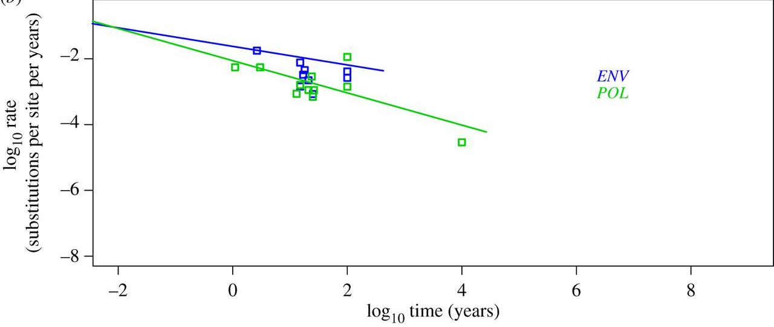
Rates of evolution can vary in the short term and long term
Duchene et al. (2014), Proceedings B
Notes:
Rates of evolution can also depend on the time frame one considers.
In short, when using shorter time windows, evolutionary rates tend to be higher than when considering longer time windows.
The way I think about this is that there are different forces at play in the short and long term.
In the short term, selection plays less of a role and the rate of evolution is more driven by the how many errors accumulated
In the long term, selection plays a bigger role and will impact the rate of evolution much more.
There is a few more processes that can impact the likely rate of evolution, such as host switches

Slide 30
Mathematically clock models are functions that have divergence as input and time as output
Strict clock models assume that evolution happens equally fast on each branch of a tree. Strict clocks are mostly used to study pathogens over rather short times (a few years)
Random clock models allow different branches of a phylogenetic tree to have different rates (speed) of evolution. These are more prevalent when analyzing datasets that were sampled over longer time periods

Slide 31
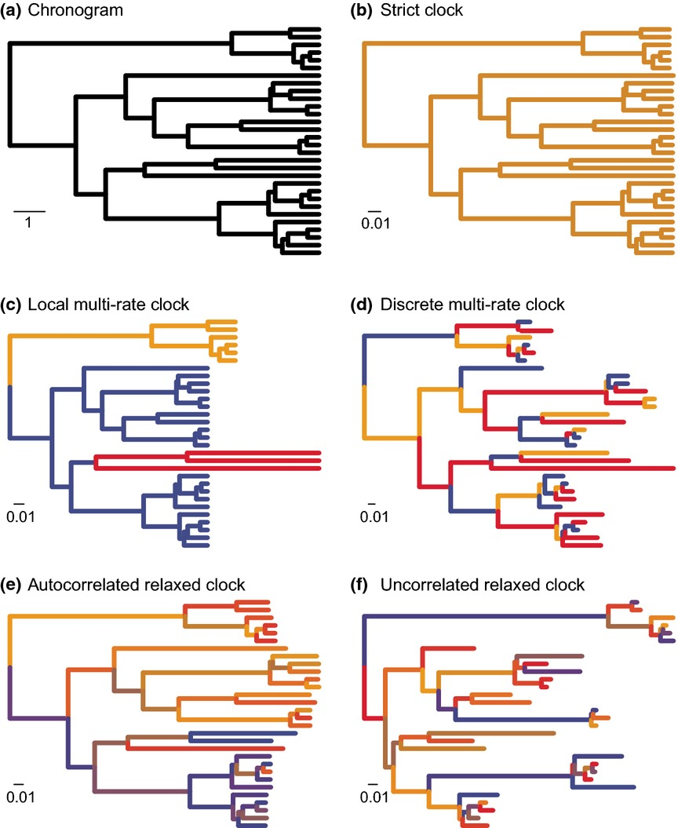
Molecular clock models map genetic divergence into time
Clock models can account for variation in the speed of evolution across an evolutionary history.
Ho et al. (2014), Molecular Ecology
Notes:
These processes are often not explicitly incorporated into our molecular clock models.
Instead, we often just allow rates to vary across different branches in a random fashion.
Local clocks assume that there are discrete point in the phylogeny where evolutionary rates change.
Random clocks assume that the rate of evolution on each branch is a random draw from some underlying distribution.
These models can accommodate some of the variations in the speed of evolution between different parts of evolutionary histories.
However, they can introduce a lot of uncertainty and can increase the computational complexity of phylogenetic analyses by quite a bit.
So, in effect, a lot, I would say most, phylogenetic analysis assume strict clock models.
This is a, sometimes necessary, assumption for analyses, that noentheless has to be kept in mind when taking about things, such as common ancestor times or branch lengths.
It is particularly important to keep in mind that uncertainty about these times might be over or underestimated and that these estimate can also be biased.

Slide 32
Where does the time information come from to inform the molecular clock?
Calibrations -> Knowing something about when two lineages shared a common ancestor.
Sampling through time of “measurably evolving pathogens”.
(Just “knowing” the rate)
Notes:
In order for clock rates to be estimated, some information about how things evolve over time must exist.
There is two main ways to get this information.
In the first, some ancestral event, or several events are known.
In paleontology, for example, this could be a fossil.
What is more common in viruses, is that there are samples isolated over some time.
In this case, the sampling times

Slide 33
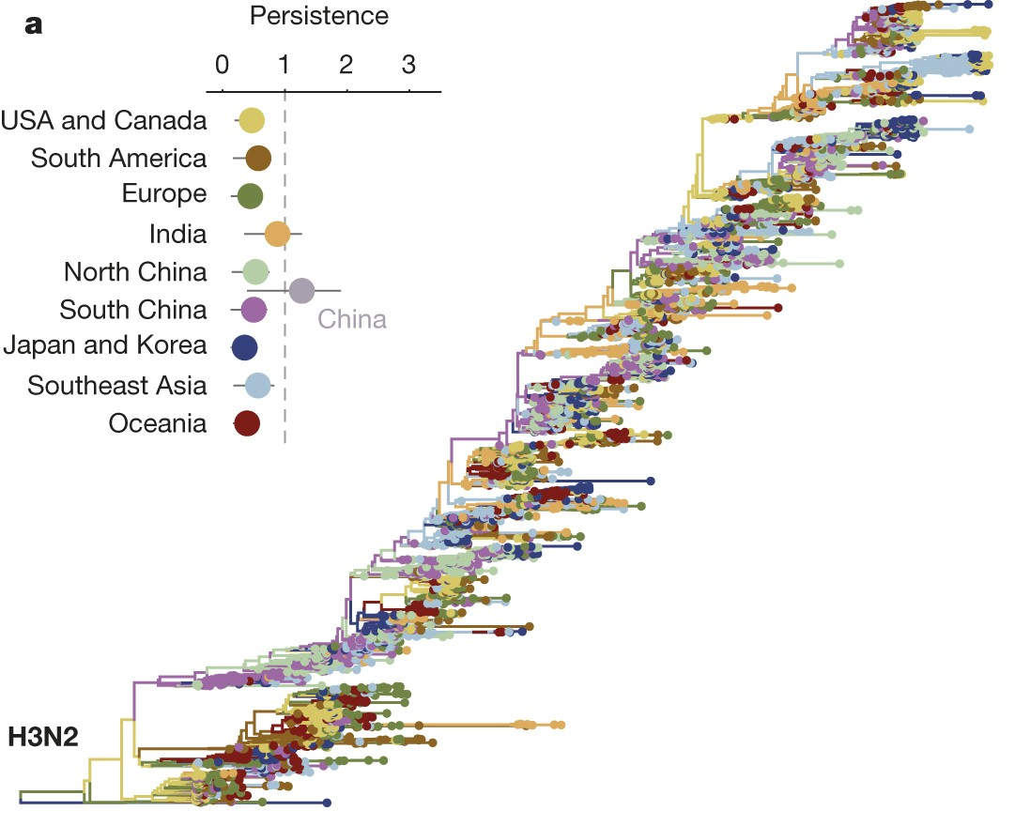
The time information should be in the same order of magnitude as the evolutionary history
Bedford et al. (2015), Nature
Notes:
If we look at this influenza A/H3N2 phylogeny, we see that the branching process happens very much on the same time scale as the sampling, which in turn gives us a lot of information about the speed of evolution

Slide 34
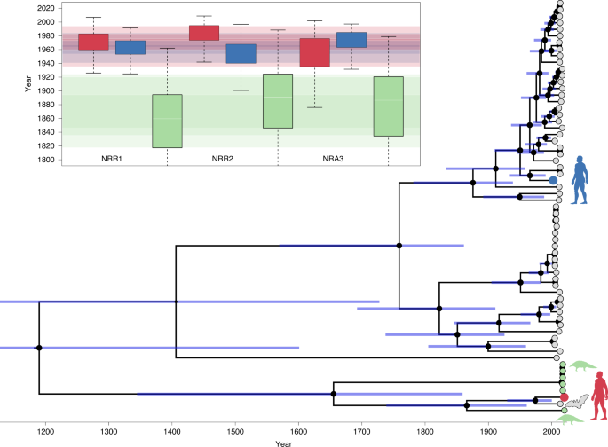
The time information should be in the same order of magnitude as the evolutionary history
Boni et al. (2020), Nat. Mic.
Notes:
If we contrast this to a SARS-like phylogeny, sampling happened over a few years, while the evolutionary history connecting the individual samples happened in the order of centuries or millennias.
In these situations, one is pretty much stuck with just assuming some rate of evolution

Slide 35
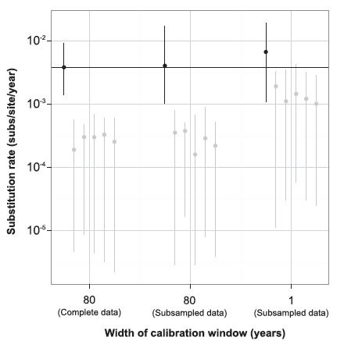
Is there enough signal to estimate evolutionary rates? Tip Randomization
Duchene et al., 2015a, MBE

Slide 36
Sequence evolution is assumed to be independent of the demographic model
Tree Prior describes how a tree was formed by a population model
Posterior probability
Tree likelihood
Du Plessis et al., 2015, Trends M.

Slide 37
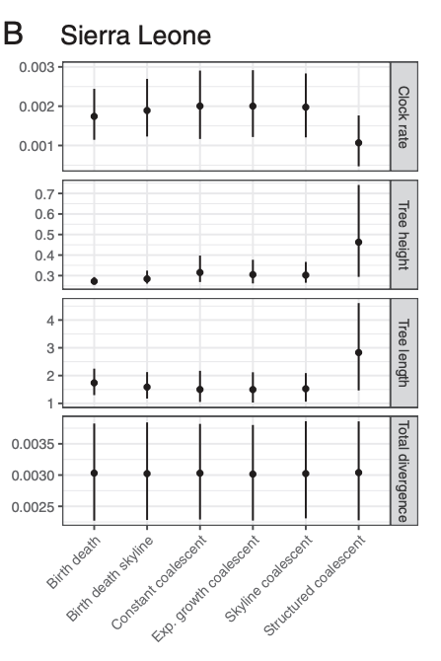
Model choices not directly related to clock models can impact rate estimates
Möller et al., 2018, PNAS

Slide 38
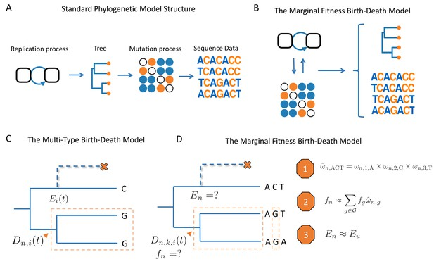
Novel models can allow for mutations to impact the fitness of a lineage
Rasmussen and Stadler, 2019, eLife.

Slide 39
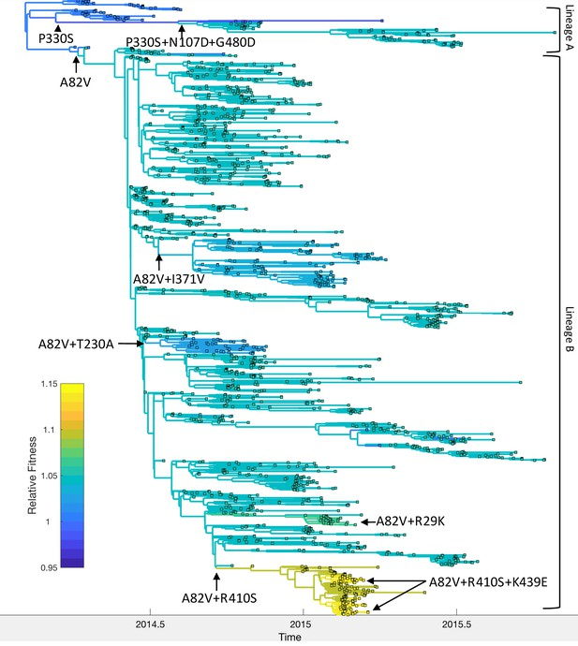
Novel models can allow for mutations to impact the fitness of a lineage
Rasmussen and Stadler, 2019, eLife.

Slide 40
Some reading material
Accounting for codon positions: https://doi.org/10.1093/molbev/msj021
Overfitting site models is ok: https://www.nature.com/articles/s41467-019-08822-w
Posterior predictive simulations to evaluate clock signal: https://academic.oup.com/mbe/article/32/11/2986/981260
Time randomization to evaluate clock signal: https://academic.oup.com/mbe/article/32/7/1895/1016979
Rates of evolution in EBOV: https://www.nature.com/articles/nature19790

